Slide 1

OVERVIEW
AIRCRAFT ACCIDENT ANALYZER
Phase 1 Project
Stephen Kamiru

Slide 2

Business Understanding
What is the business looking to do?
Well, the business is looking to expand it’s portfolio by diving into the airspace field. The business is interested in purchasing and operating airplanes for commercial and private enterprises.
However, they do not know how to go about this as they have never been in this field.
The aircraft analyzer will focus on helping the business make data-driven decisions on what planes to acquire maintaining the low risk-high return module.

Slide 3

What data are we dealing with?
The data that we will be working on was provided by the National Transportation Safety Board.
The data focuses on accidents of different aircrafts collected from the year 1962 to 2003.
This data has multiple columns including but not limited to: Event.Id', 'Investigation.Type', 'Accident.Number', 'Event.Date', 'Location', 'Country', 'Airport.Name', 'Injury.Severity', 'Aircraft.damage', 'Aircraft.Category', 'Registration.Number', 'Make', 'Model', 'Amateur.Built', 'Number.of.Engines', 'Engine.Type', 'Purpose.of.flight', 'Total.Fatal.Injuries', 'Total.Serious.Injuries', 'Total.Minor.Injuries', 'Total.Uninjured', 'Weather.Condition', 'Report.Status', 'Publication.Date', 'Aircraft

Slide 4
Cont’
The columns have different values. Some of which we will not use. We will even get rid of some of the columns that will not help in making the decisions for the company.
The columns that helped in making the decisions were: 'Aircraft.damage’,
'Number.of.Engines’,
'Purpose.of.flight’,
'Total.Fatal.Injuries', 'Total.Serious.Injuries', 'Total.Minor.Injuries', 'Total.Uninjured’,
'Aircraft’.

Slide 5
Cont’
These columns, after cleaning (to get rid of the missing values and to make sense of the data) provided crucial details on the data.

Slide 6
DATA ANALYSIS:
We first loaded the data on our editor.
Cleaned the data.
Obtained information and shape of the data.
Created a new column(Aircraft) by merging Make and Model columns.
Created visualizations based on the data.

Slide 7
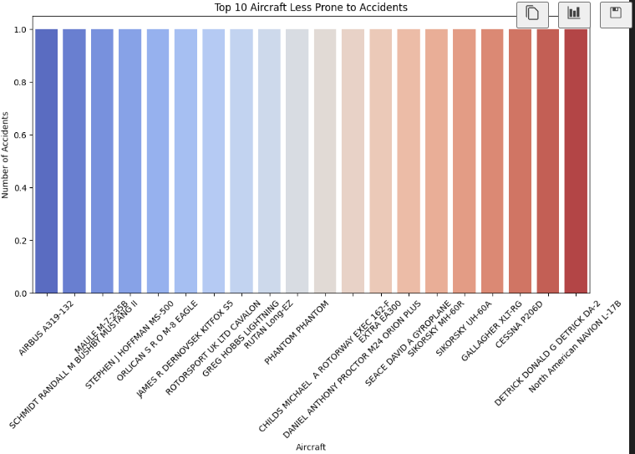
Recommendations:
From the visualizations, the following recommendations were issued:
What planes were less prone to accidents?

Slide 8
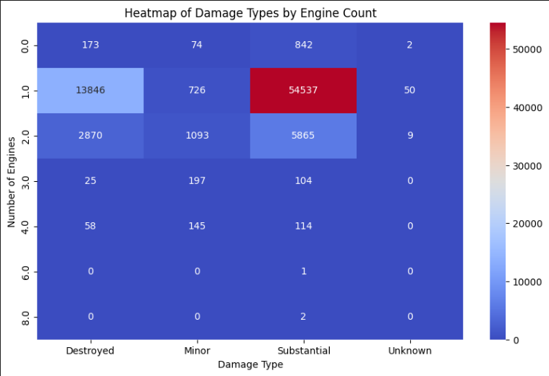
Cont’
How did the number of engines correlate to the number of accidents?

Slide 9
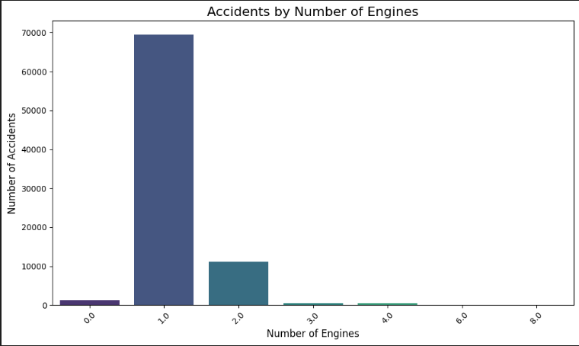
Cont’
The more the number of engines the less the chances are for an accident to occur.

Slide 10
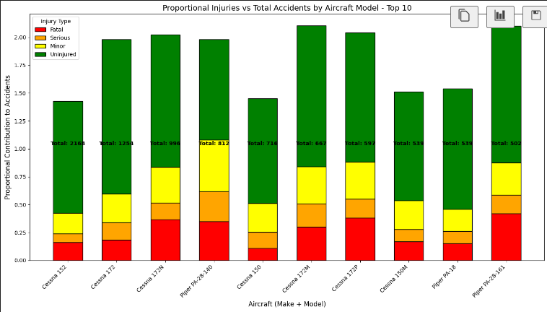
Cont’
What are the type of injuries experienced by passengers in the event of an accident?

Slide 11

SOME OF THE RECOMMENDATIONS…
The safest planes to acquire solely based on the likelihood of them being in an accident are the SIROSKY make.
Ideally, having more than one engine on the plane is way safer than having just one as in case of failure of the one, there is an increased likelihood of there being an accident so having more than one will increase the safety and lower the likelihood of these accidents (will provide ‘cover’)
In the long run, the `ge Havilland` make is cheap. This is because, in the event of an accident, this makes sustains relatively minor damages that can therefore be fixed as compared to the planes that are usually fully destroyed thus needing an extensive amount to acquire new planes.

Slide 12
What next?
Next, the stakeholders will have a view of the recommendations and then make data-driven decisions as the look to venture into this new field.

Slide 13

Q & A
All questions are welcomed!!

